Slide 1
IP Camera Security System

Slide 2
Presentation Overview
1
Project Description
2
Technologies
3
Software System Architecture
4
System Implementation
5
Conclusion

Slide 3
Project Description
Create a Prototype of a Network Security System using IP Camera Technology
  Designed for Irish home broadband user.
  Alerts home owner to break-in by SMS.
  Owner may view intruder faces and a live stream from the IP camera on a J2ME mobile application.

Slide 4
Project Description
Functional Requirements:
  IP Camera
    Stream MJPEG.
    Motion Detection Alert.
  Server:
    Image Processing: Face Detection/Recognition.
    SMS & E-mail Alert.
  Phone
    View Intruder/Recognised Faces
    View MJPEG Stream

Slide 5
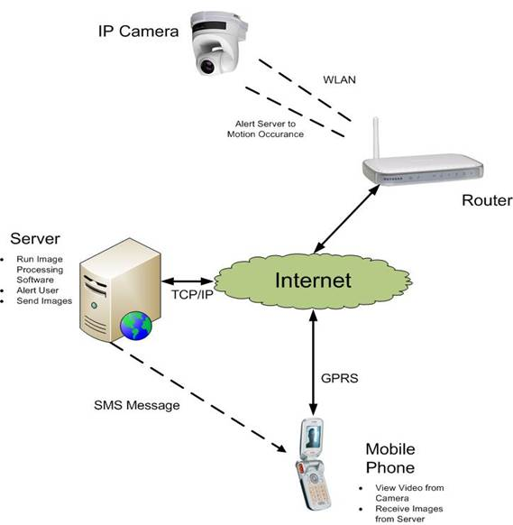
Project Description

Slide 6
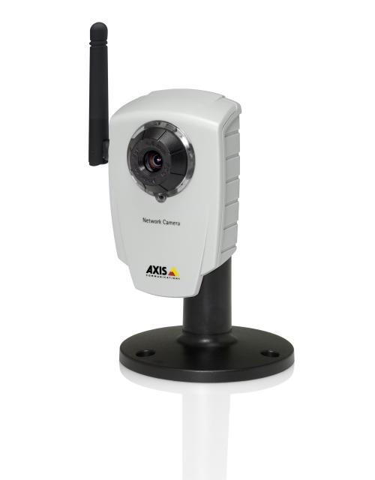
Technologies
Communication Technologies
  TCP/IP
  HTTP Protocol
  GPRS
IP Camera Technology
  Web Server
    Standalone
  Motion Detection
Axis 207W
© Axis Corporation 2006

Slide 7
Technologies
Software Technologies
  J2SE/J2EE
    Servlets
    J2SE Sockets
  Image Processing
    Face Detection: OpenCV
    Eigenfaces Recognition Technique
  J2ME
    MIDlets
    Sockets

Slide 8
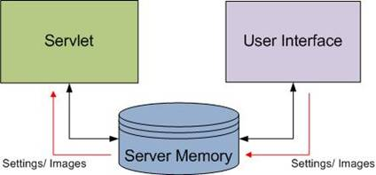
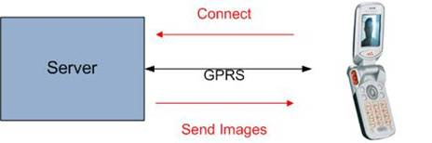
Software System Architecture
Server
  Save Images
  SMS & Email Alert
  Image Processing
  Socket Server
Mobile Device
  Socket Client
  Stream MJPEG

Slide 9
Software System Architecture
Server
Servlet
Tomcat Container
Invoked by Camera
Image Processing
Socket Server
User Interface
System GUI
Saves Images
System Settings
Viewing MJPEG

Slide 10
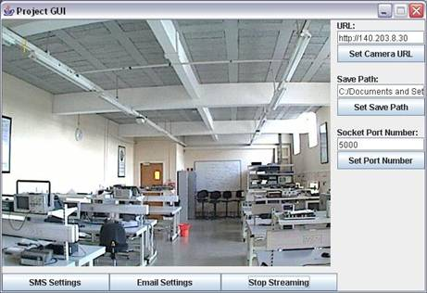
System Implementation
User Interface
  Saves JPEG’s to Server Memory
  User may:
    Edit and save camera, e-mail and SMS settings.
    View MJPEG from camera

Slide 11
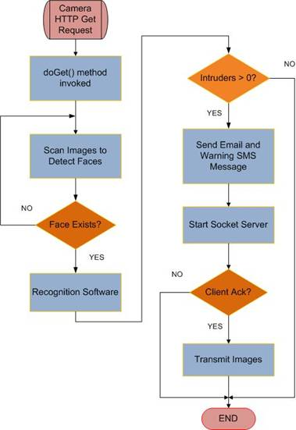
System Implementation
Servlet
  Receives Motion Alert from IP Camera
  Executes Image Processing Applications
  Issues Alerts
    E-mail
    SMS
  Start Socket Server
    Send Images

Slide 12
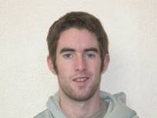

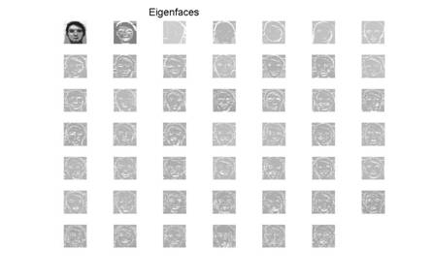
System Implementation
Image Processing
  Face Detection: C & OpenCV library
    Haar Object Detection Technique.
  Face Recognition: MATLAB
    Eigenfaces Recognition Technique
    Results determined by Euclidean Distance of Eigenfaces.
=>

Slide 13
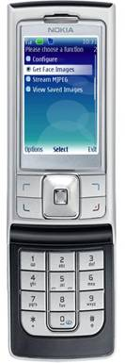
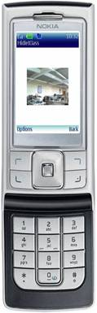
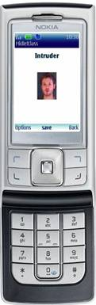
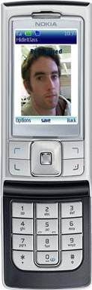
System Implementation
J2ME Application
  Start Socket Client
    StreamConnection
      “socket://server:port”
  Save Images
    RMS RecordStore
  View Live Camera Footage
    HttpConnection

Slide 14
System Implementation
J2ME Client <–> J2SE Server
Socket Connection
  ISP Settings
  Server
    JPEG to Byte Array Conversion
    Setup Connection on Specified Port
  Client
    Connect to SocketServer at an Address and Port
    Receive Byte Array and Convert to J2ME Image
    Display Image

Slide 15
Conclusion
Requirements Vs Results.
  All Requirements met.
  Image Processing Results
Overall:
  Excellent Experience
    Utilises a number of Software and Communication protocols and technologies.
  Existing IP Surveillance Systems
  Enhancements
  Feasible Product?

Slide 16
Questions?

